Slide 1


Slide 2


Slide 3


Slide 4


Slide 5


Slide 6


Slide 7


Slide 8


Slide 9

Notes:
- *09:00* - Introduction - *09:30* - Exercise 01 - 04 - *11:00* - Break - *11:30* - Exercise 05 - 06

Slide 10
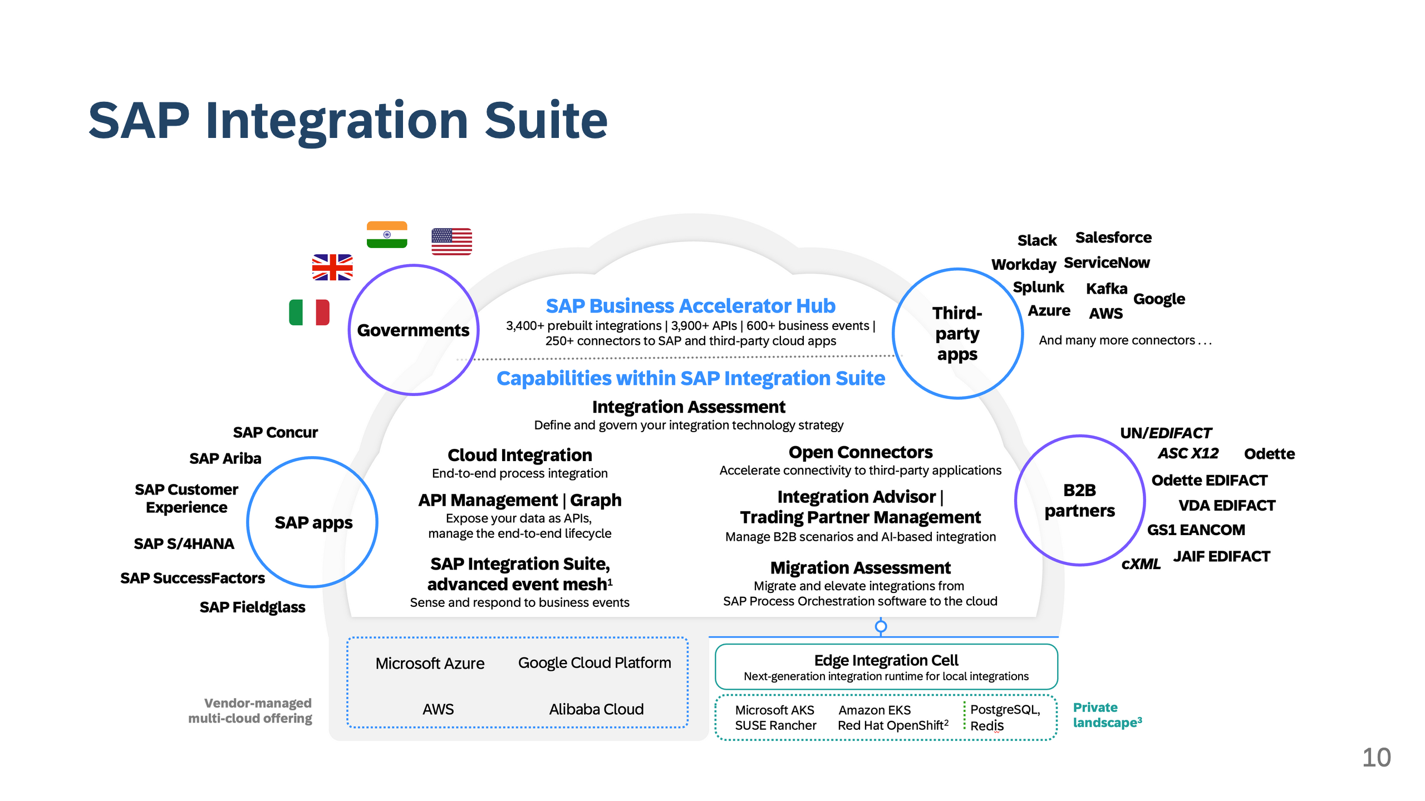

Slide 11
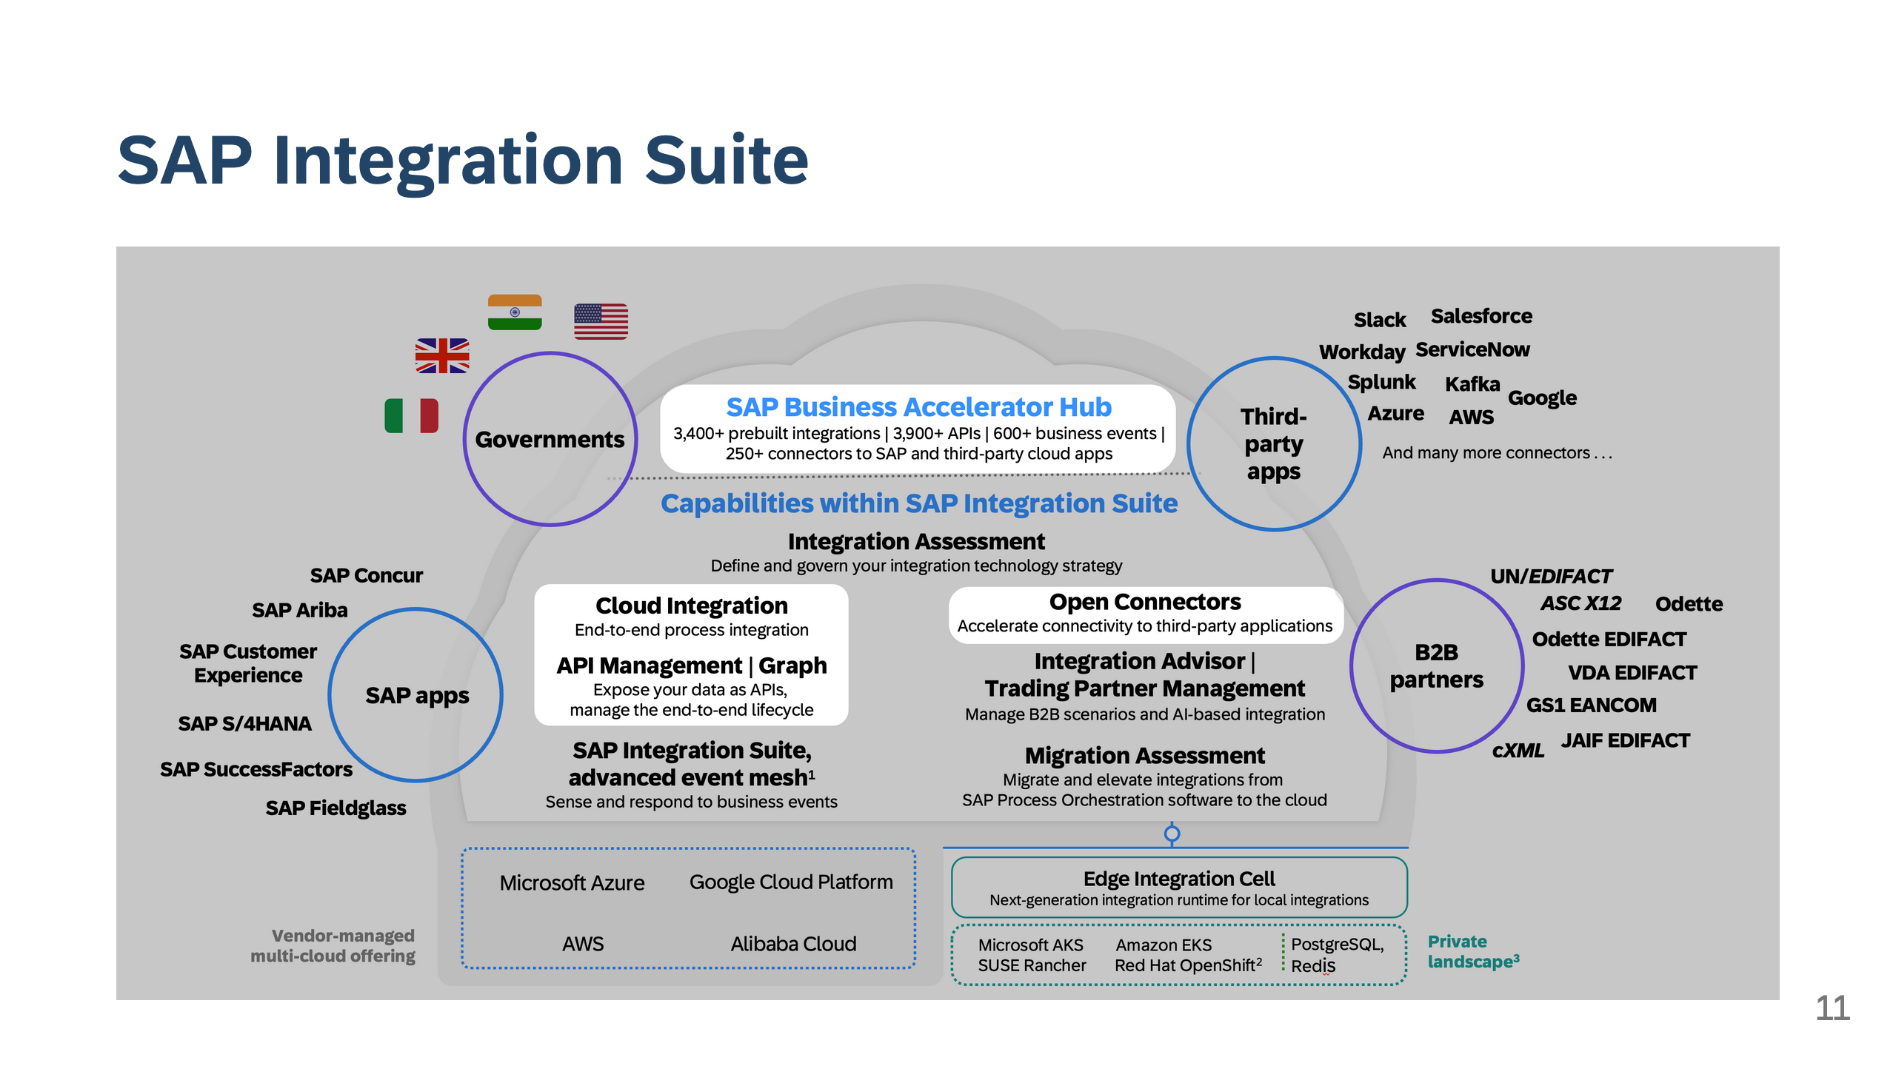

Slide 12
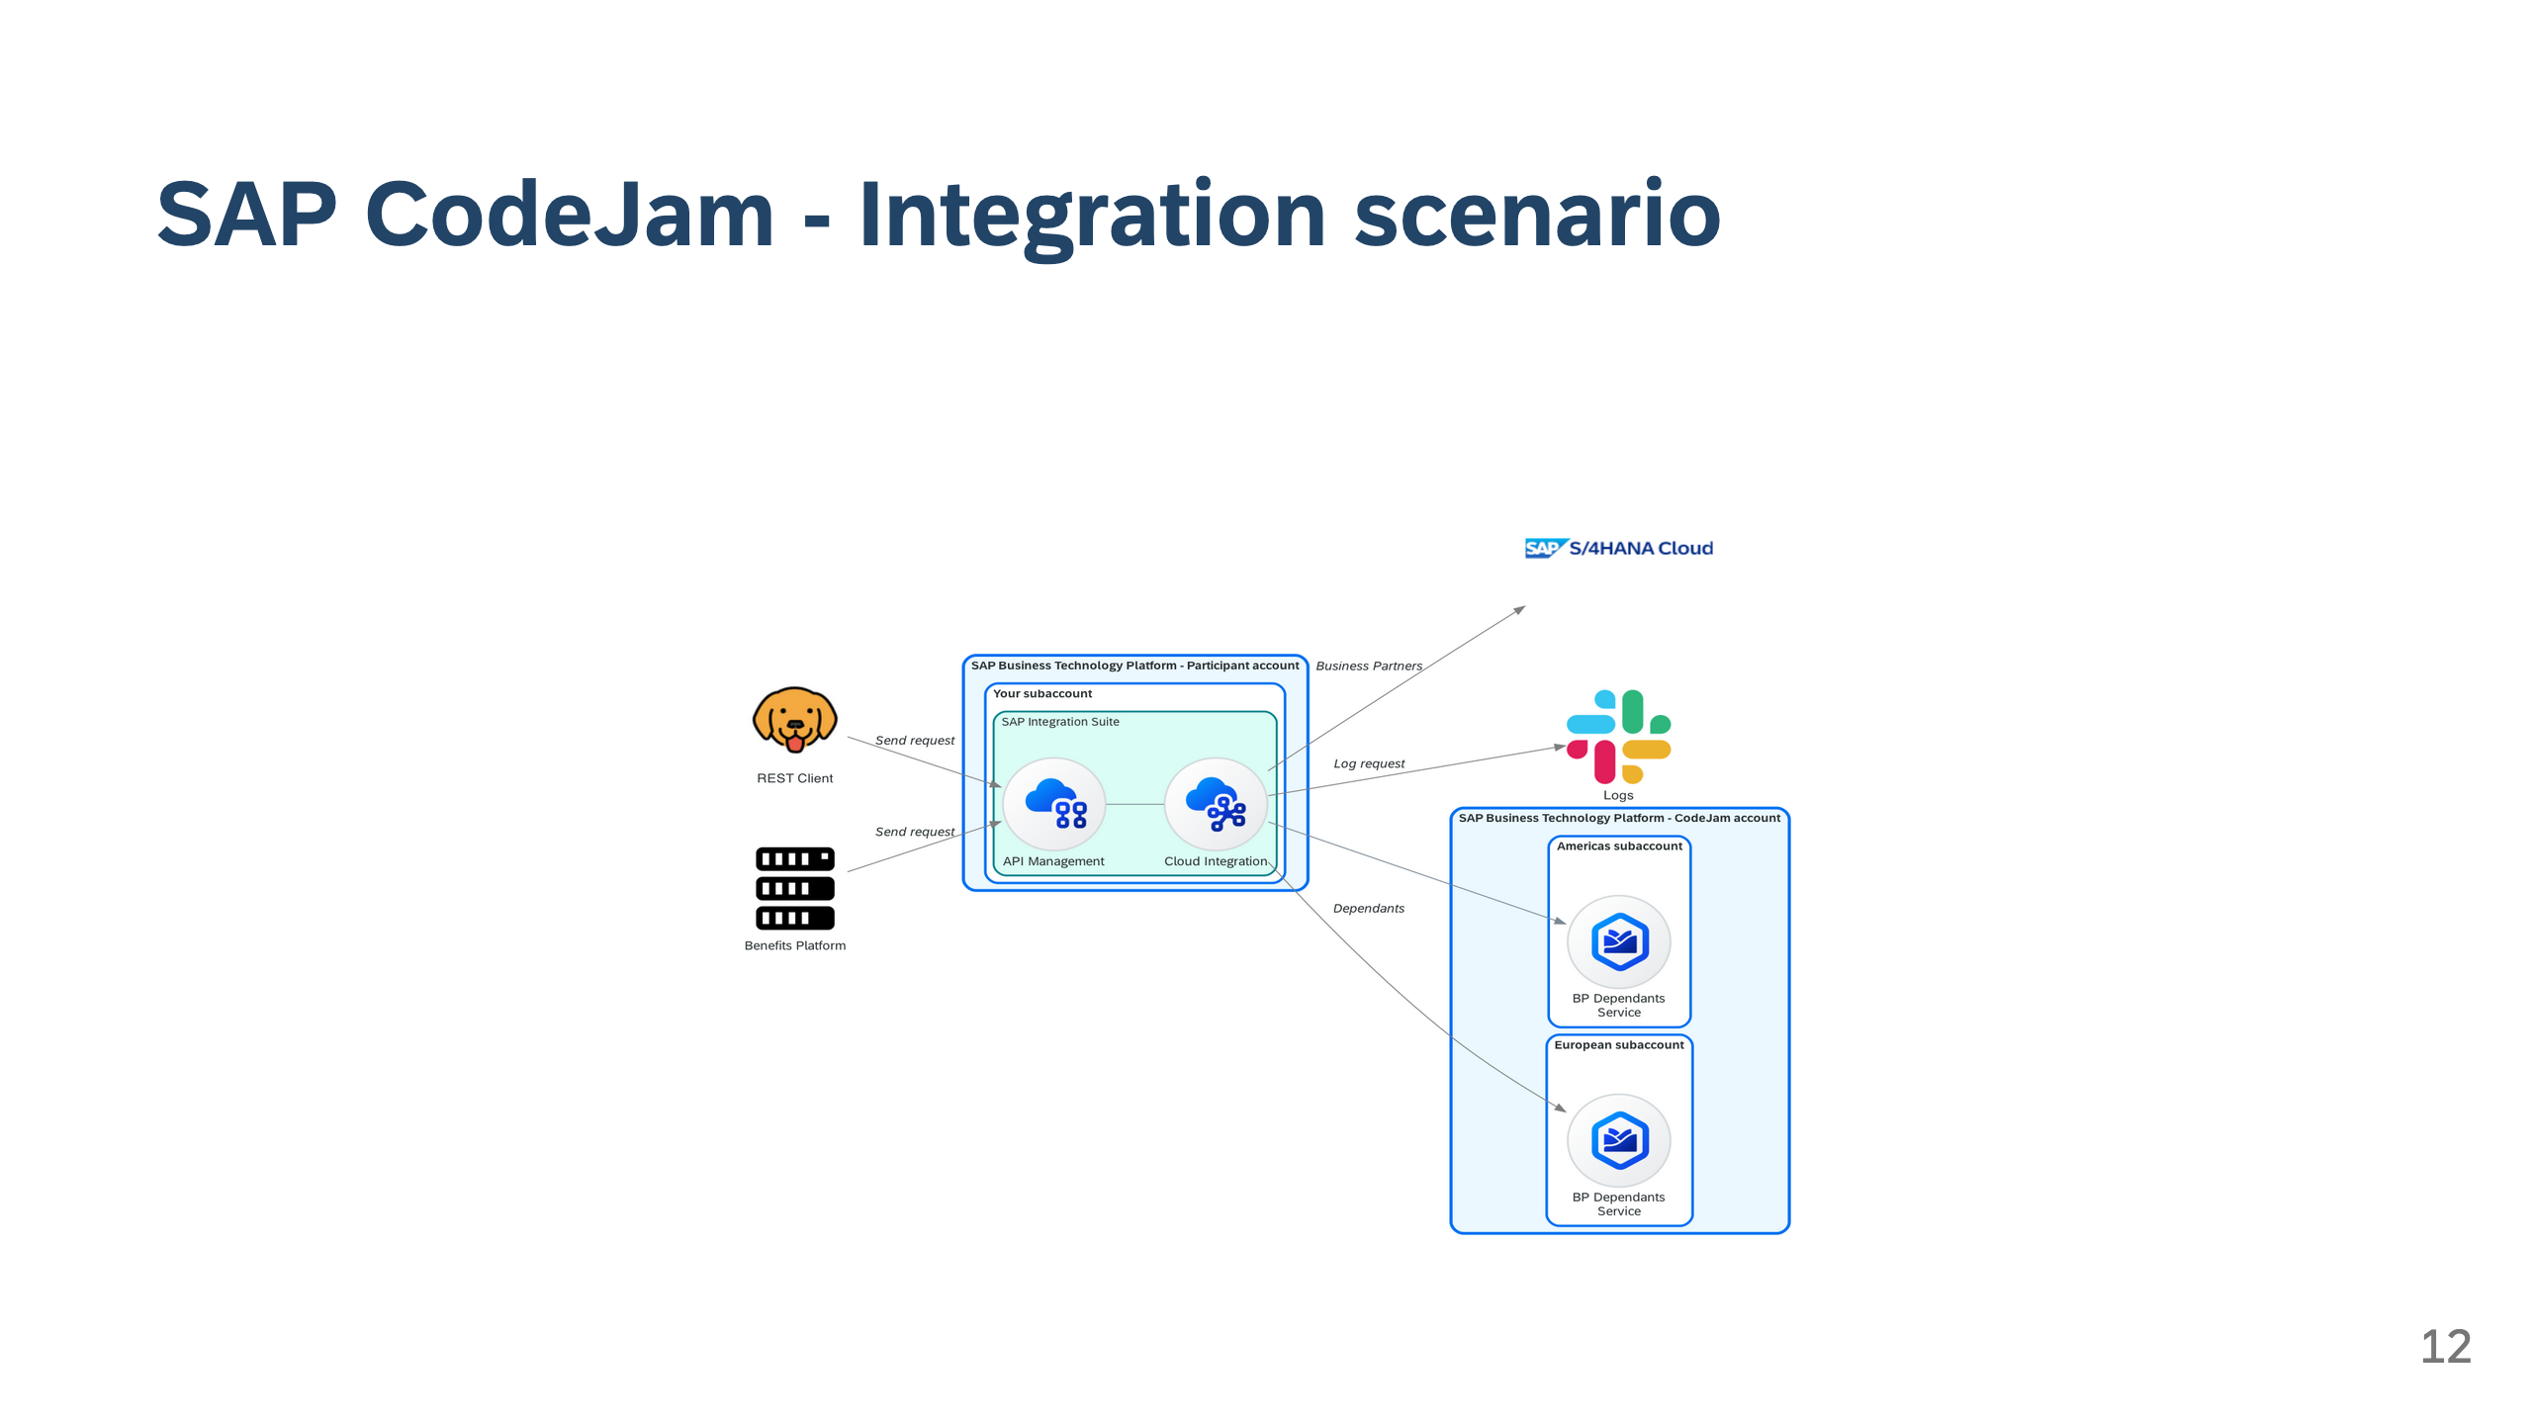

Slide 13
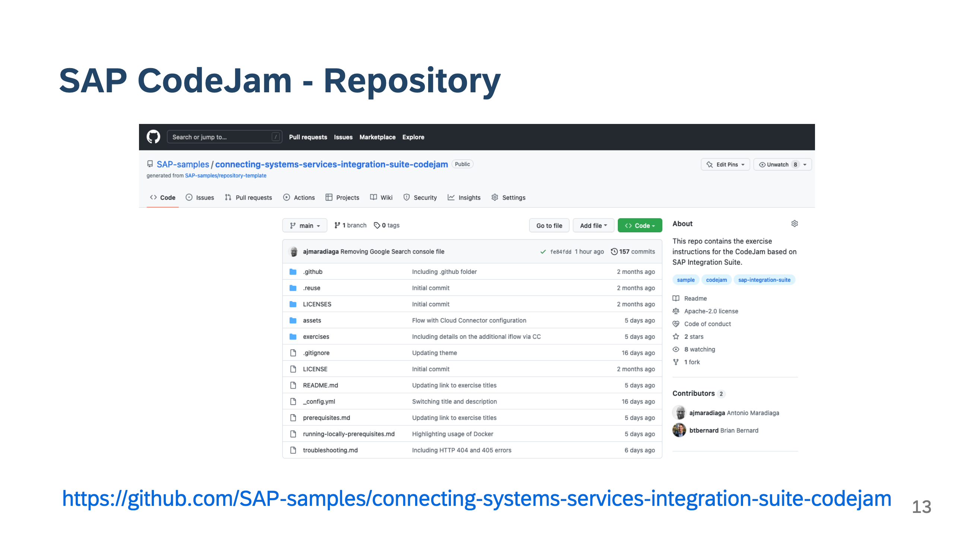

Slide 14
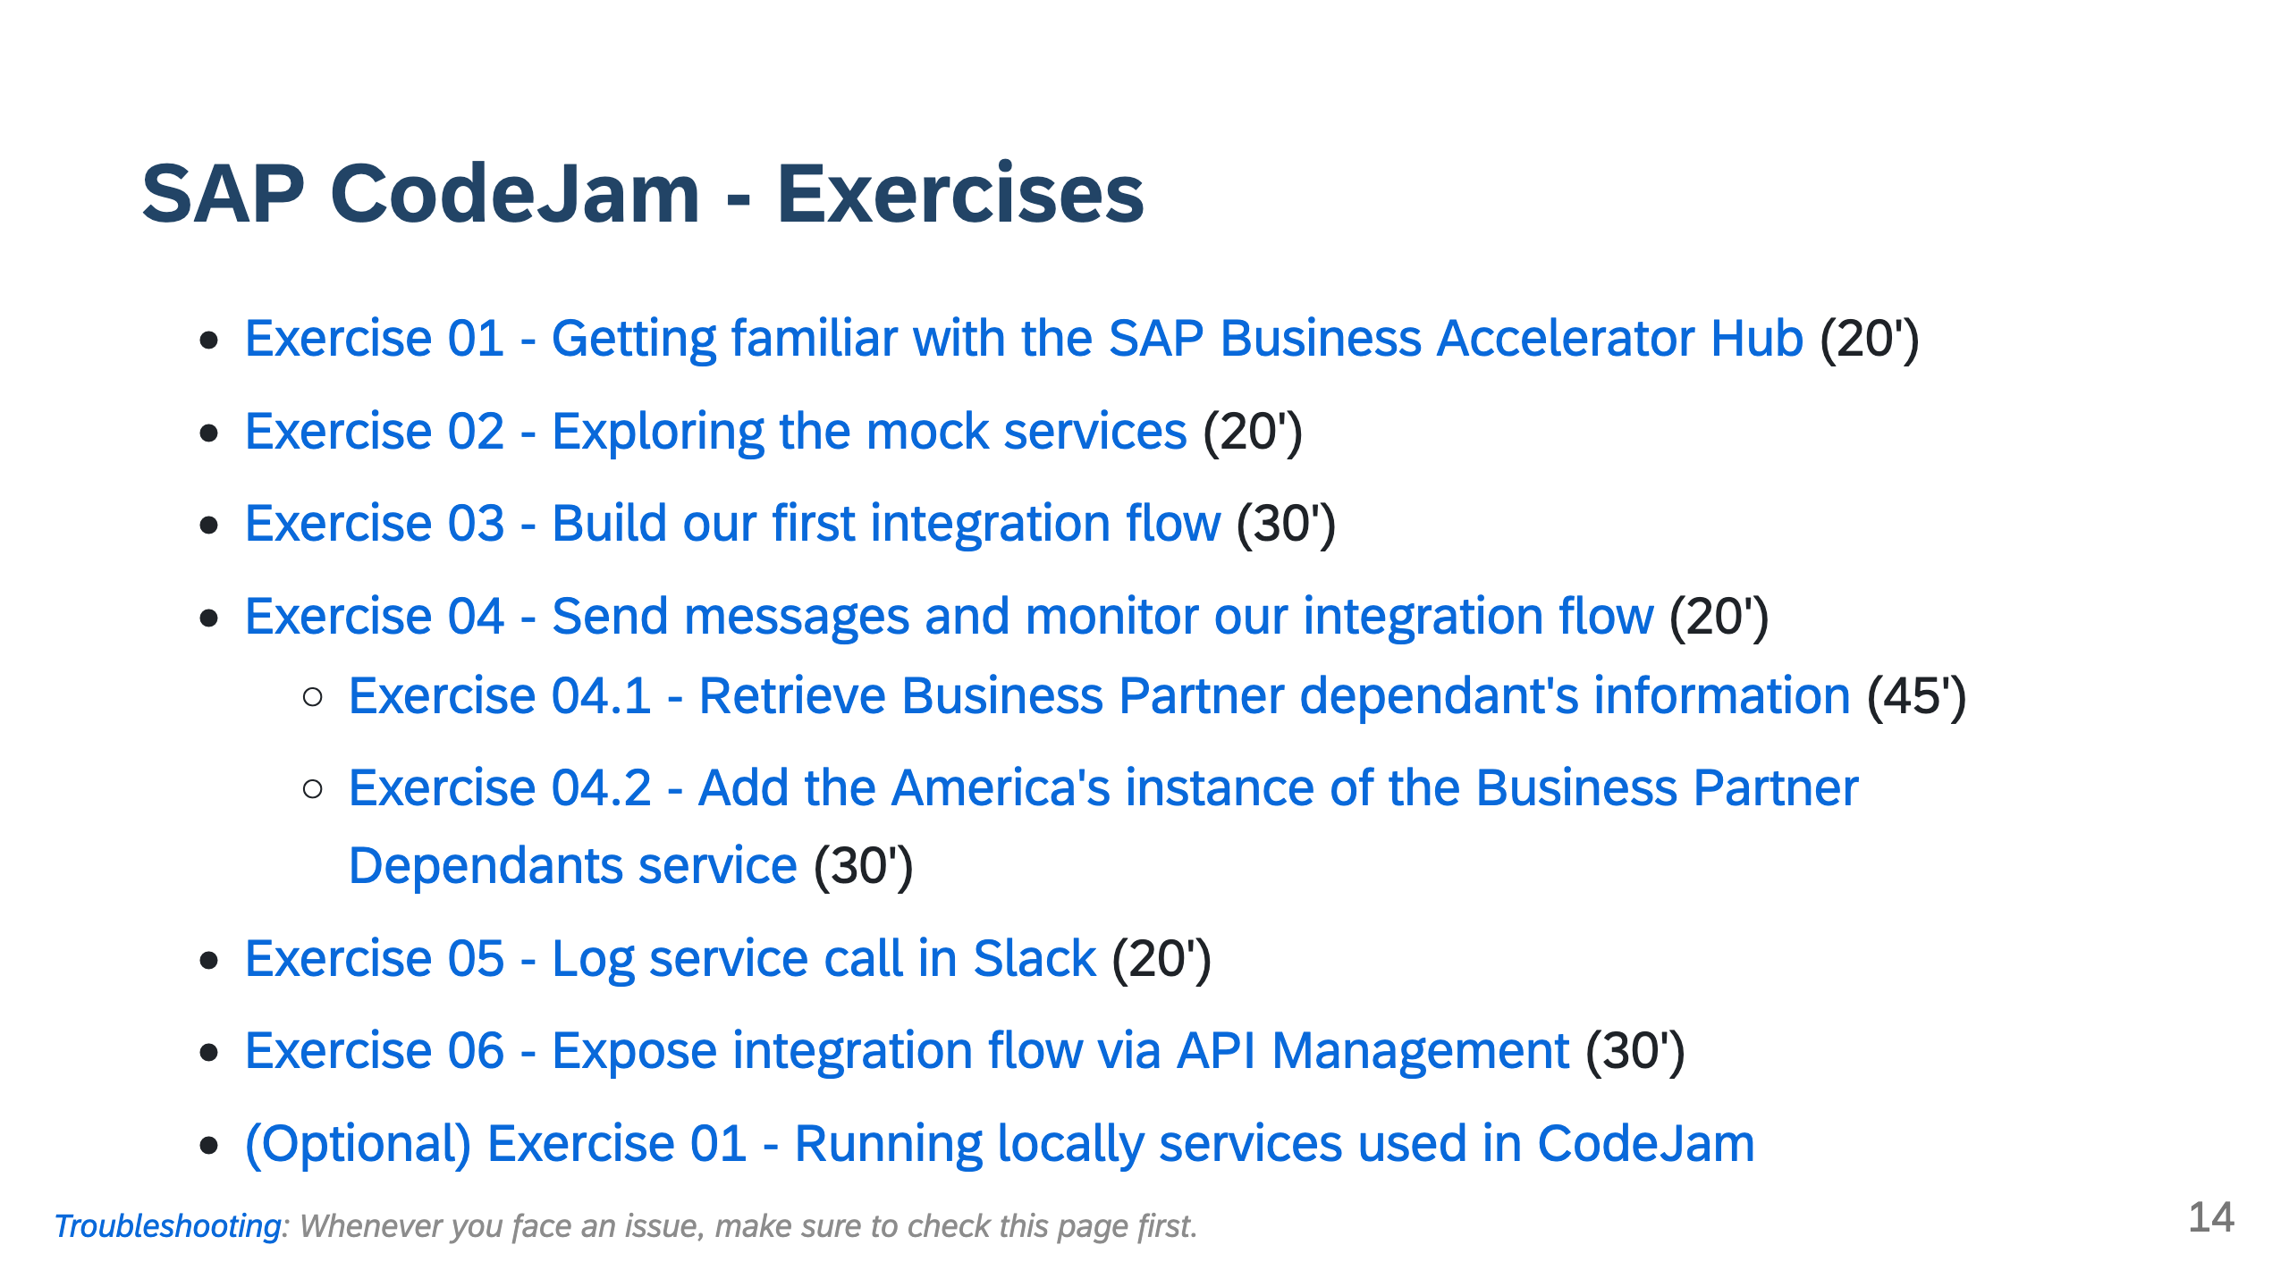

Slide 15
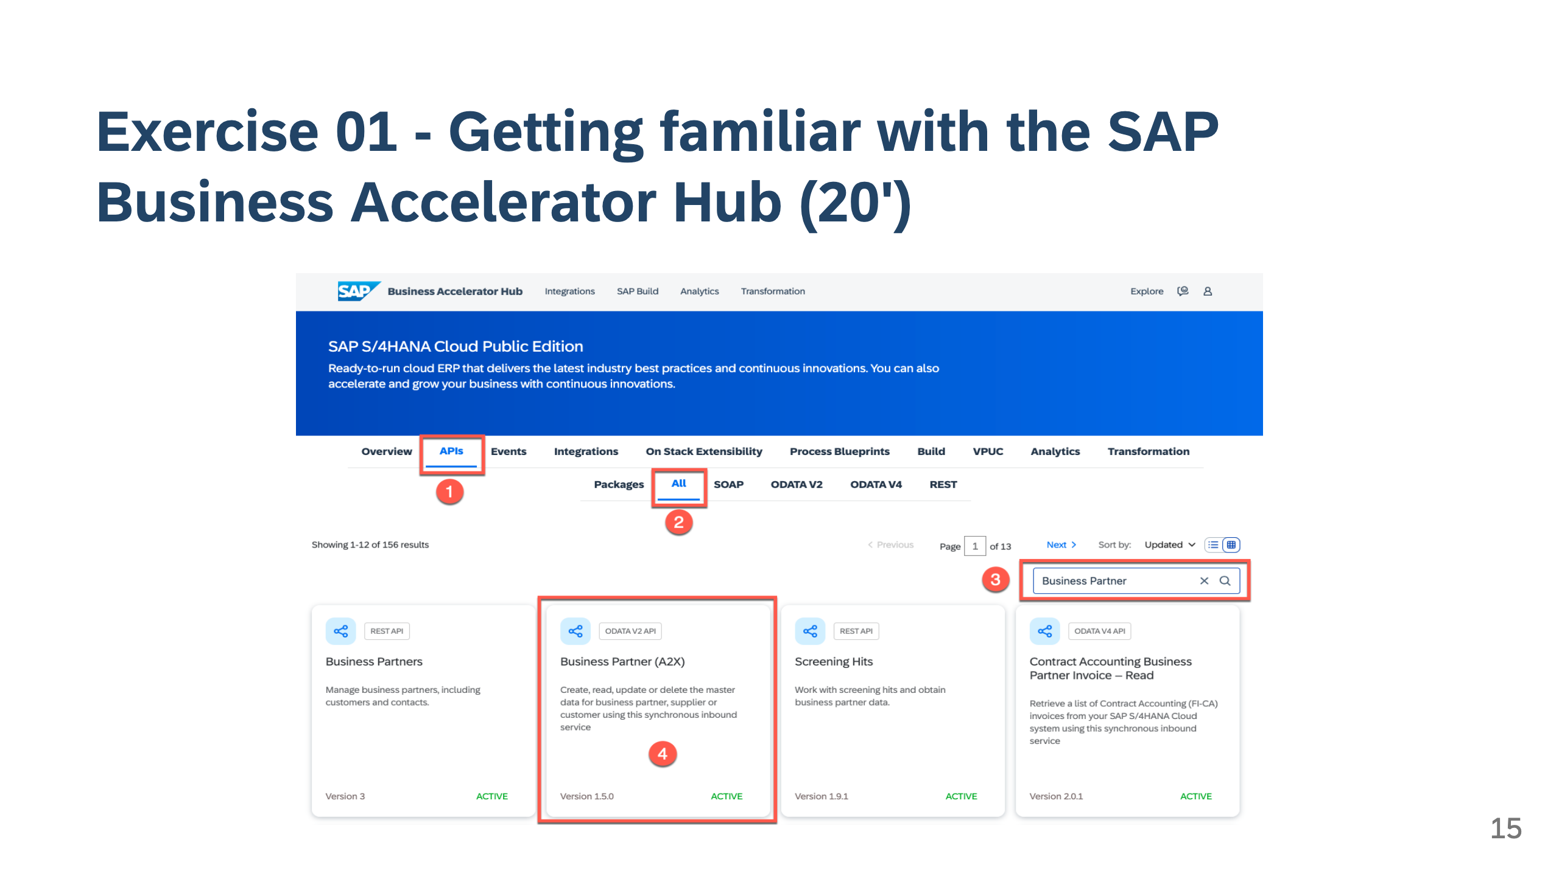

Slide 16
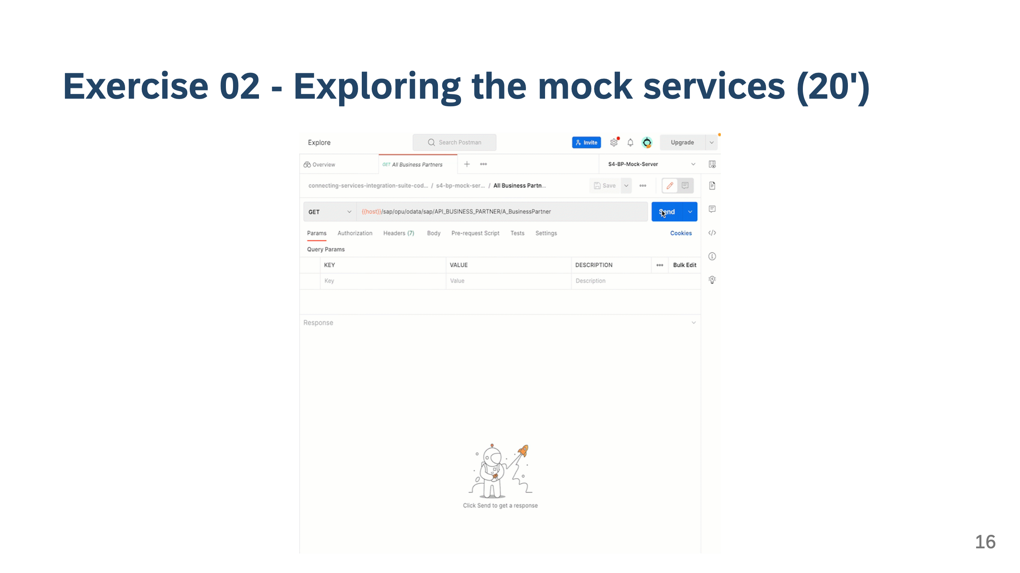

Slide 17
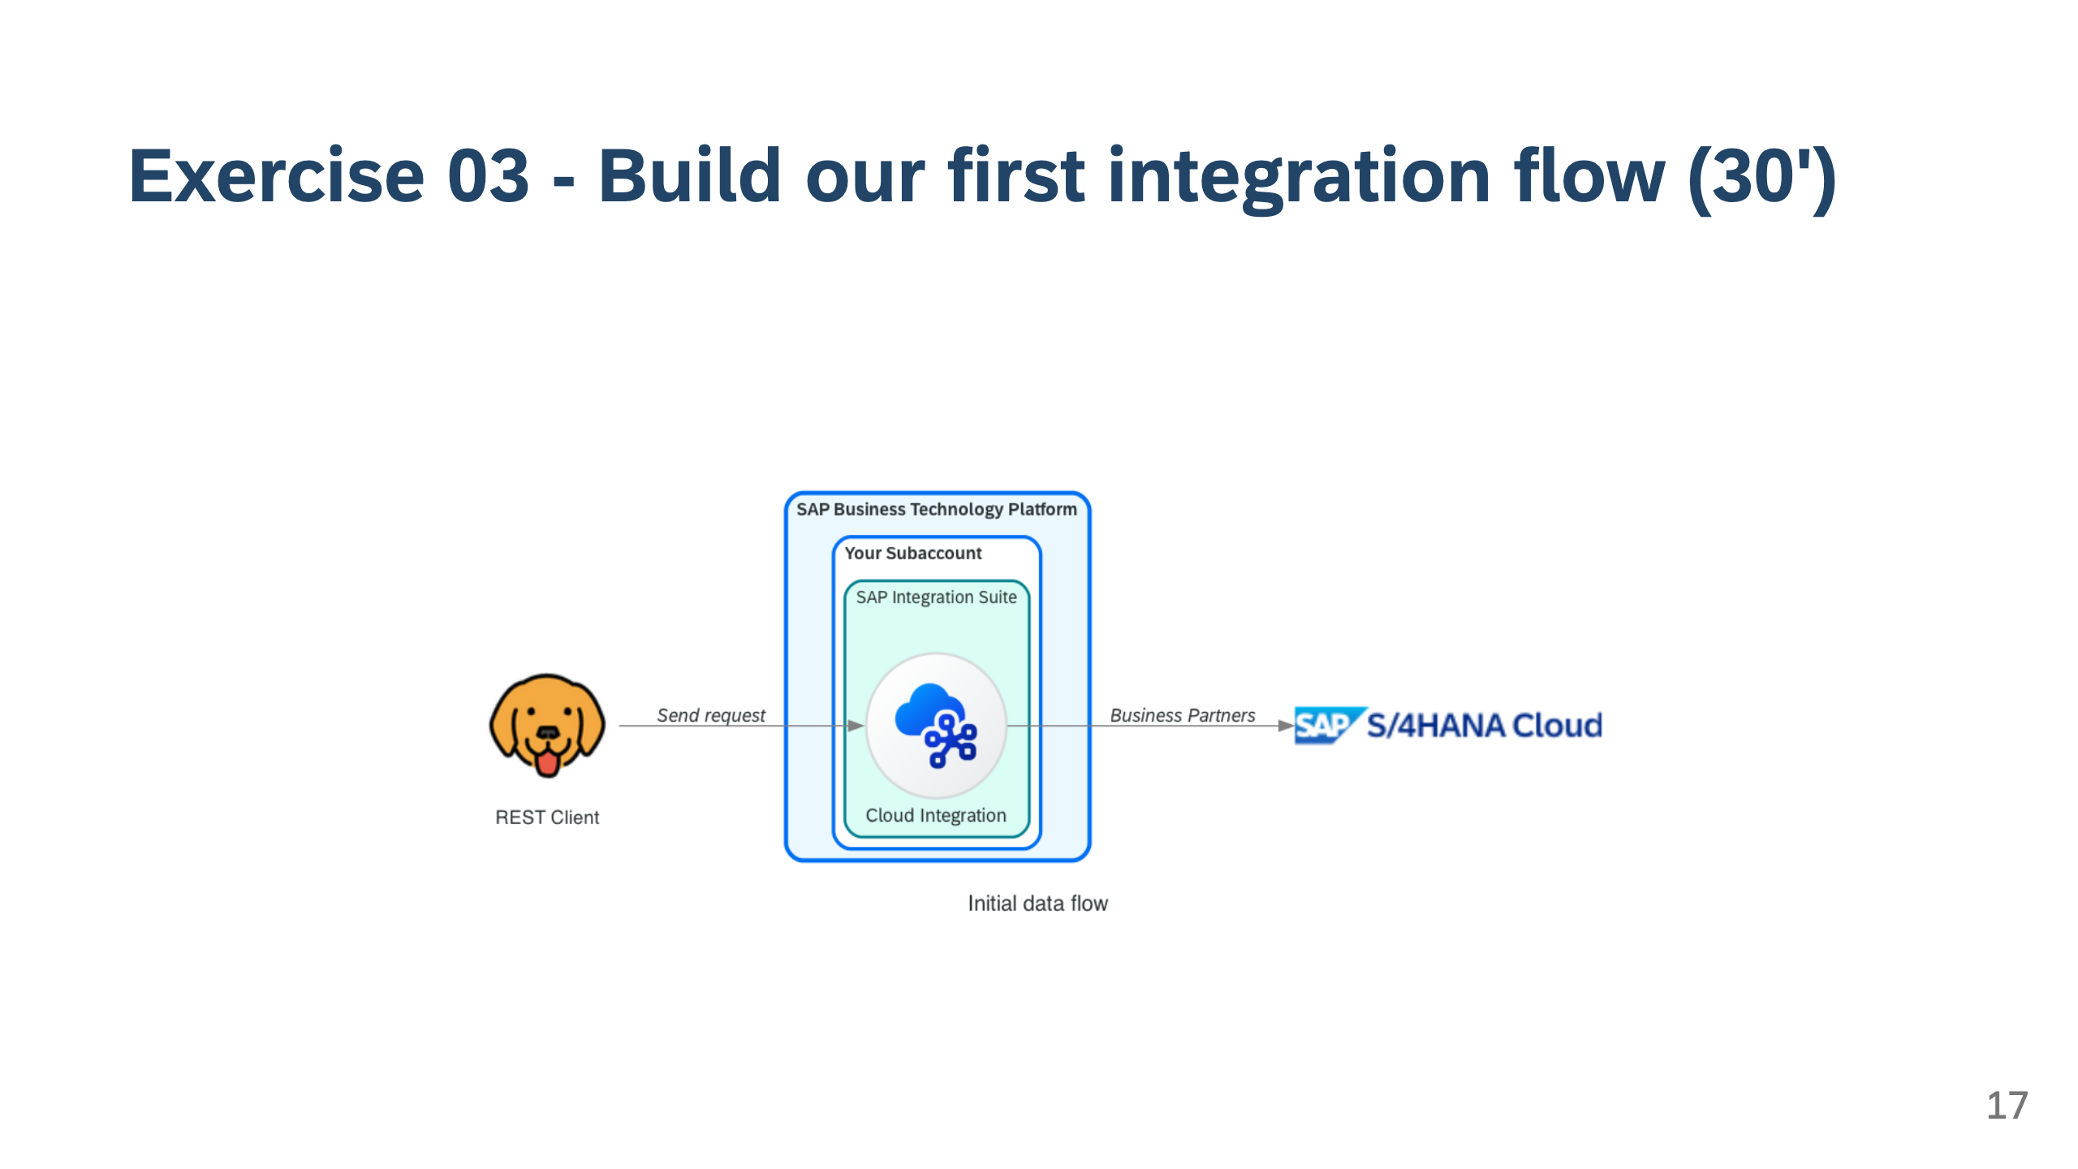

Slide 18
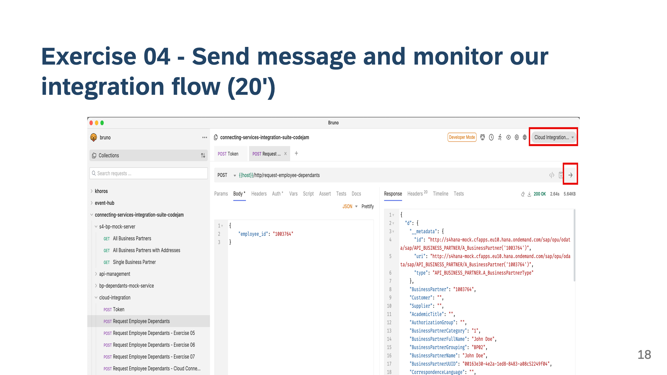

Slide 19
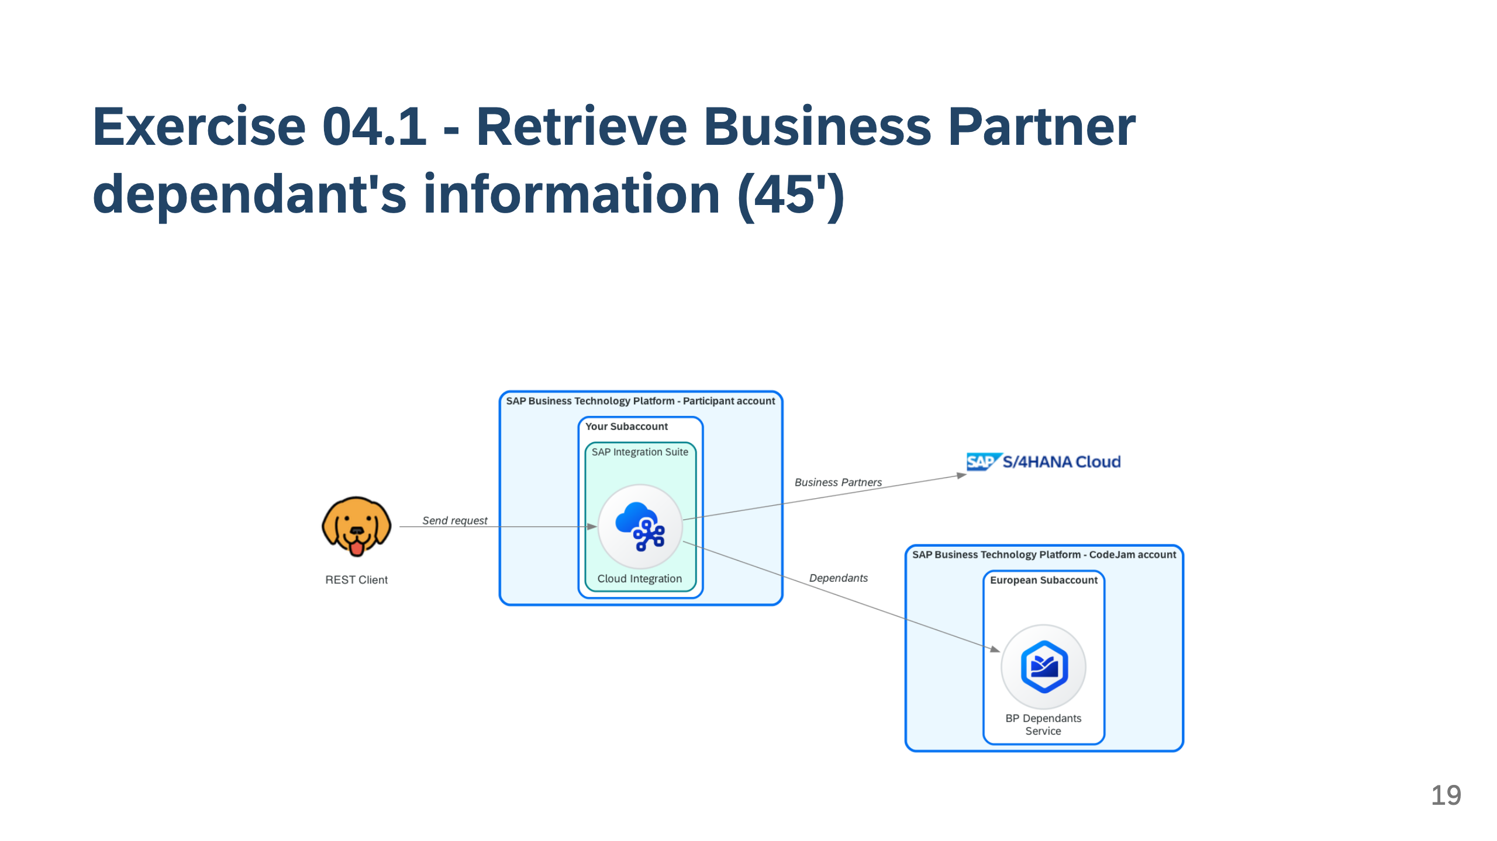

Slide 20
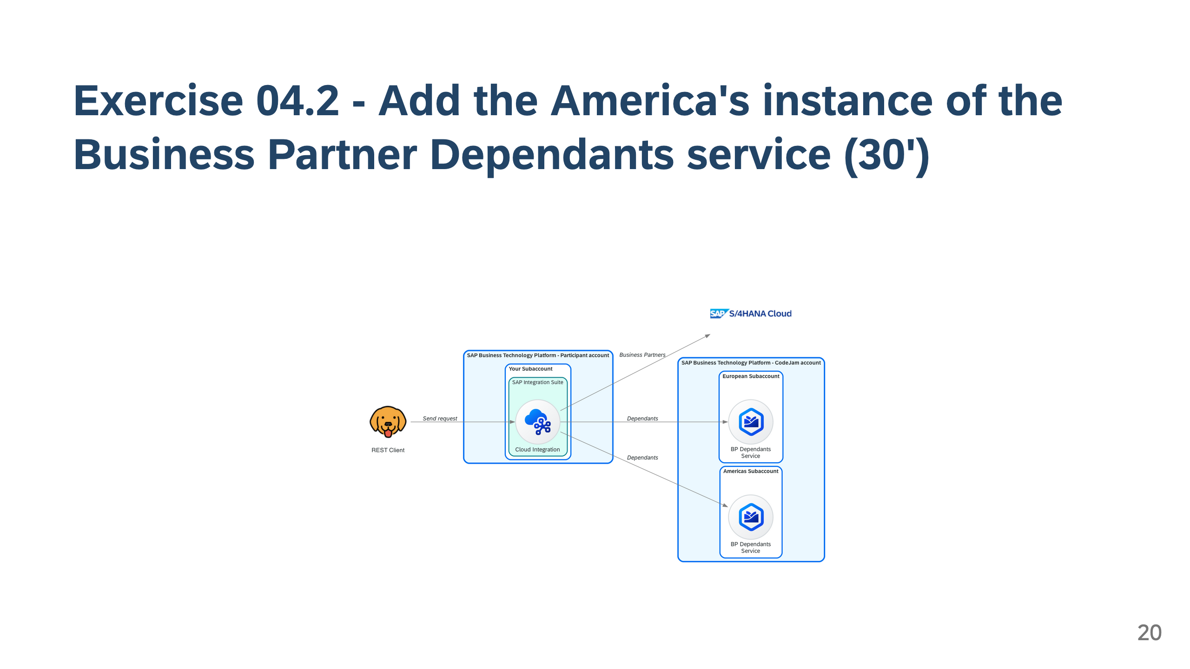

Slide 21
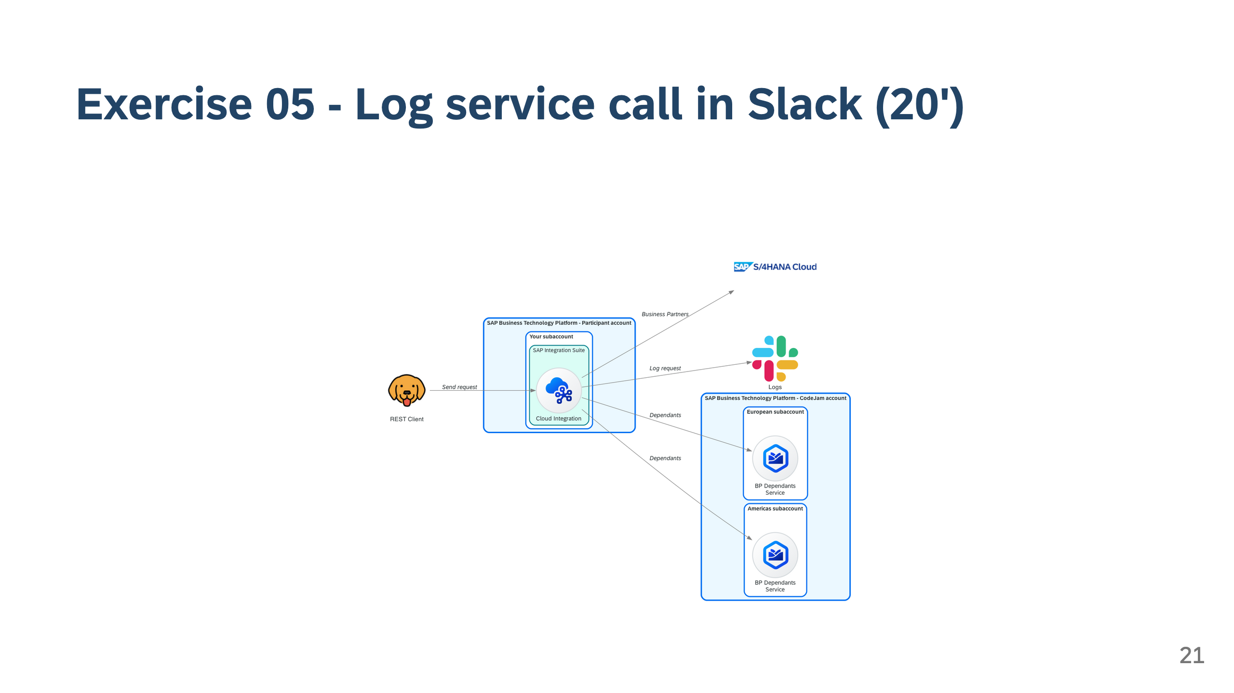

Slide 22
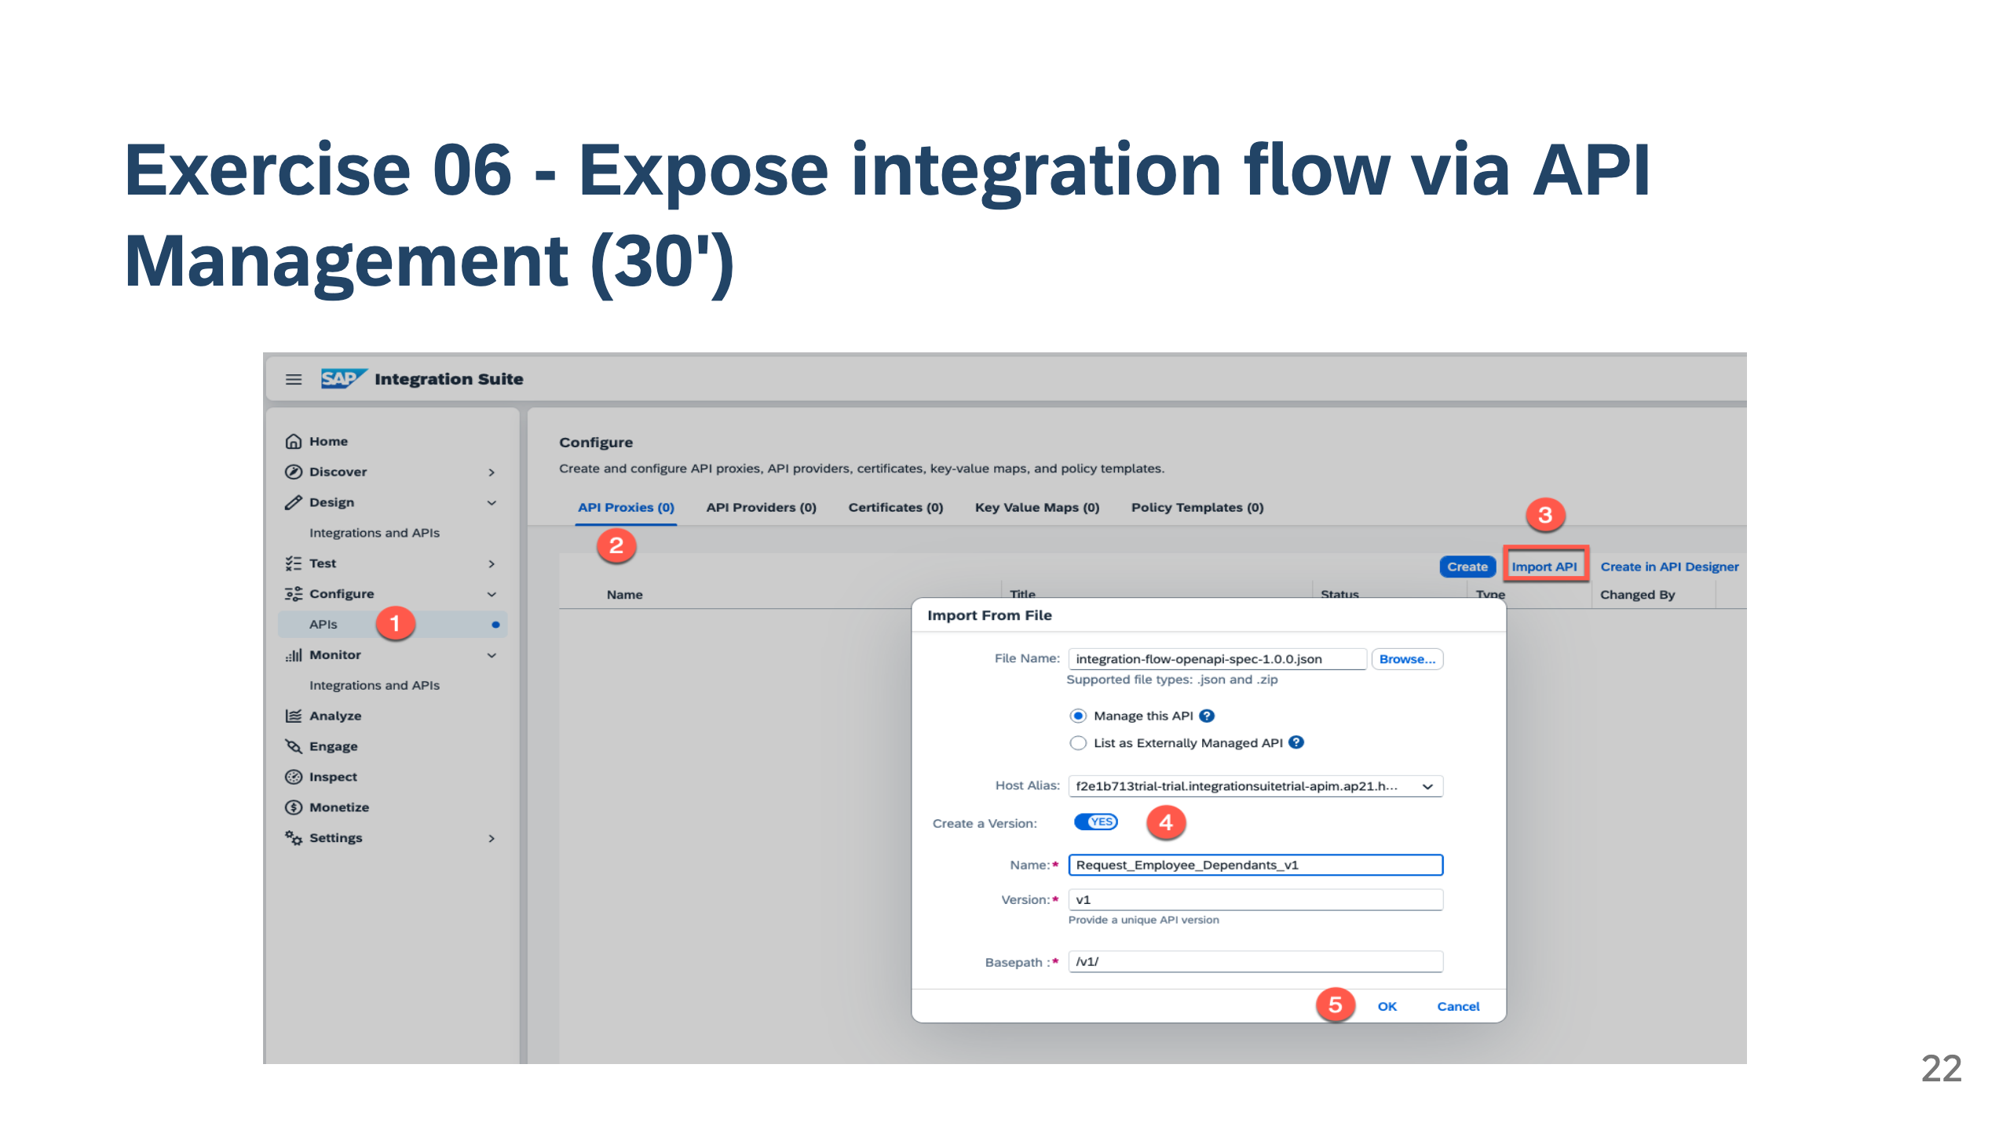

Slide 23


